Slide 1



Slide 2

Todays Agenda
Intros and News
Student Showcase – AI / ML Cancer Research
MCP Usage with Cloudflare
MCP + Open-WebUI + Pipelines + LangGraph
Wrap up and after party upstairs at The Tavern

Slide 3

HI , I’m Colin McNamara
Entrepreneur: Co-founder of Always Cool Brands, focusing on private-label products and health-conscious goods (LangChain User)
Founder of Austin LangChain AIMUG: Leading an 800+ member AI community in Austin.
10% Developer: Former Oracle Cloud Infrastructure lead with experience in hyper-scale cloud building, operations, engineering, and design.
Public Good: Helping our community succeed
LinkedIn:

Slide 4
Who we are
1100+ Members Strong: Connecting Austin’s tech, creative, and business leaders passionate about AI.
Learning in the Open: Leaning AI through the Lense of LangChain, pulling the ecosystem together.
40-50 Active Attendees per Meeting: A mix of local innovators, enthusiasts, and early adopters.
Supportive & Engaged Community: A well-balanced Discord that’s "useful, but not overwhelming."

Slide 5
Learning in the Open – "Be Cool to Each Other" ✌️
Respect & Inclusivity: Our only rule is simple: “Be cool to each other, don’t be gross.”
AI Enthusiasts of All Levels Welcome: We celebrate diverse perspectives and unique paths in AI.

Slide 6
Where and when we meet 🌟📅
Monthly Showcases & Mixer - ACC RGC3000: Community members and vendors share projects, demos, and labs for hands-on learning.
Hacky Hours (Mid-Month) - Rotating Local Bars: Informal happy hours at local spots; meet, discuss, and relax.
Weekly Virtual Syncs - Online: Tuesdays & Thursdays at 2 PM – Workshopping, problem-solving, and AI discussions.

Slide 7
Where to Connect & Stay Updated 📲
Website: aimug.org – All things LangChain and AIMUG.
Discord: Join us for ongoing conversations.
GitHub: Austin LangChain Repo – Check out our open-source projects.
Meetup: Austin LangChain Group
Twitter: @AustinLangChain – Latest updates and AI news.
YouTube: Austin LangChain Channel – Watch replays and tutorials.

Slide 8
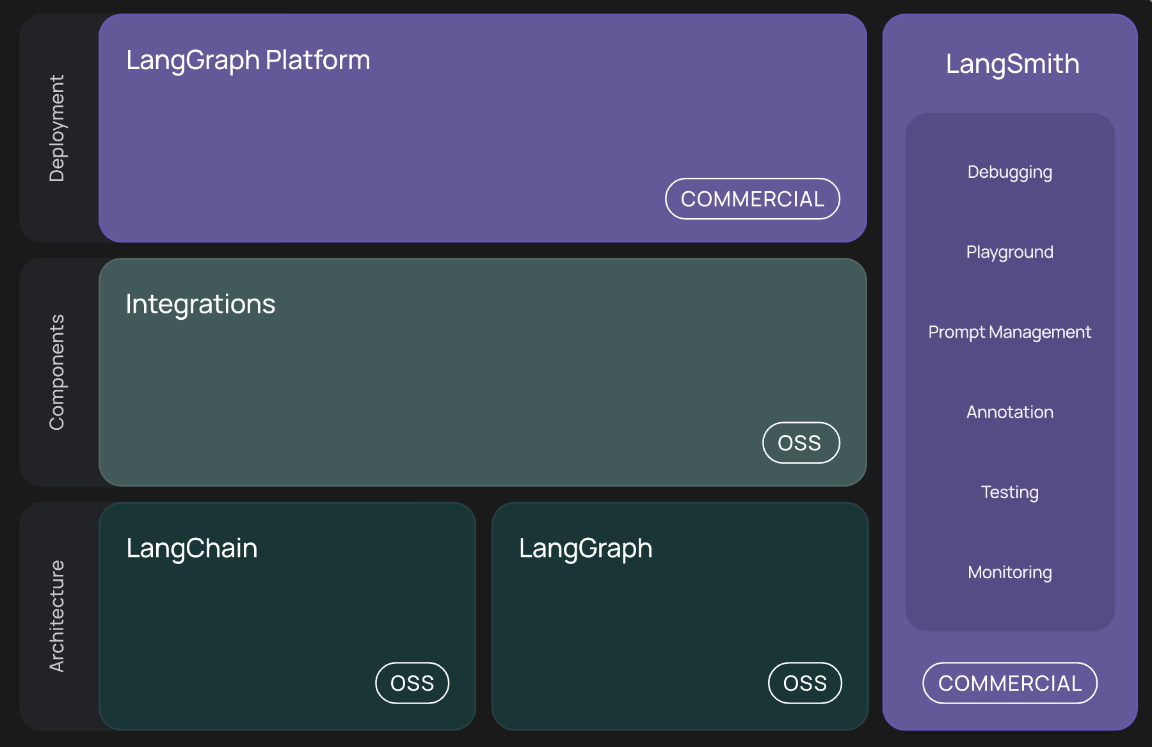
What’s LangChain

Slide 9
Student Showcase

Slide 10
MCPs on CloudFlare

Slide 11
MCP + Open-WebUI + Pipelines + LangGraph

Slide 12
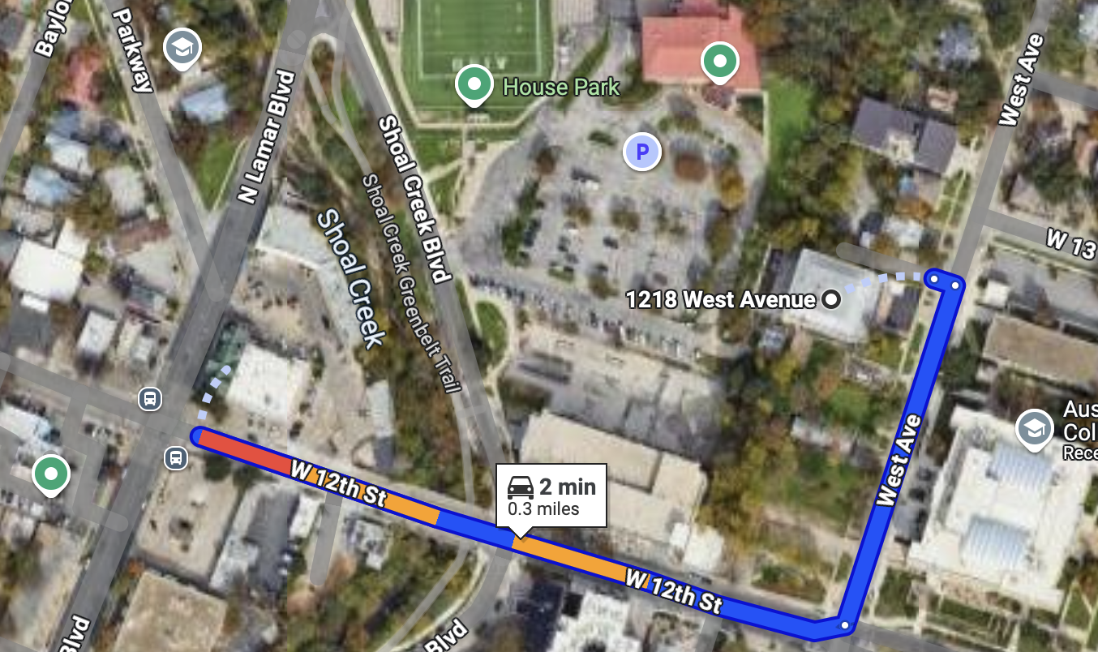
RGC-3000 and Tavern After Party
Website: aimug.org – All things LangChain and AIMUG.
Discord: Join us for ongoing conversations.
GitHub: Austin LangChain Repo – Check out our open-source projects.
Meetup: Austin LangChain Group
Twitter: @AustinLangChain – Latest updates and AI news.
YouTube: Austin LangChain Channel – Watch replays and tutorials.
ACC RGC3000
The Tavern
ACC Main Campus

Slide 13
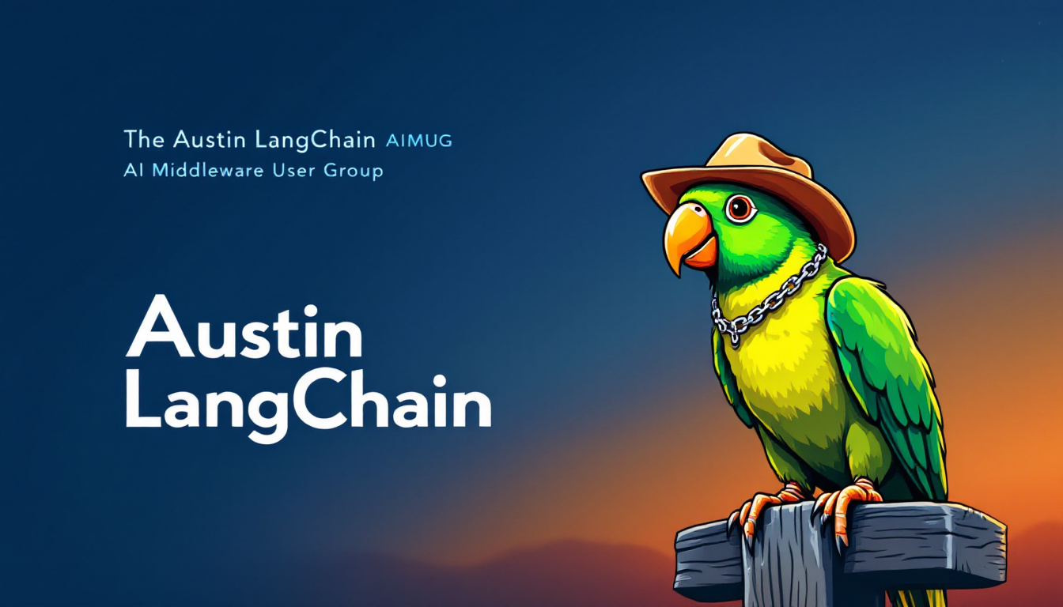

Slide 14
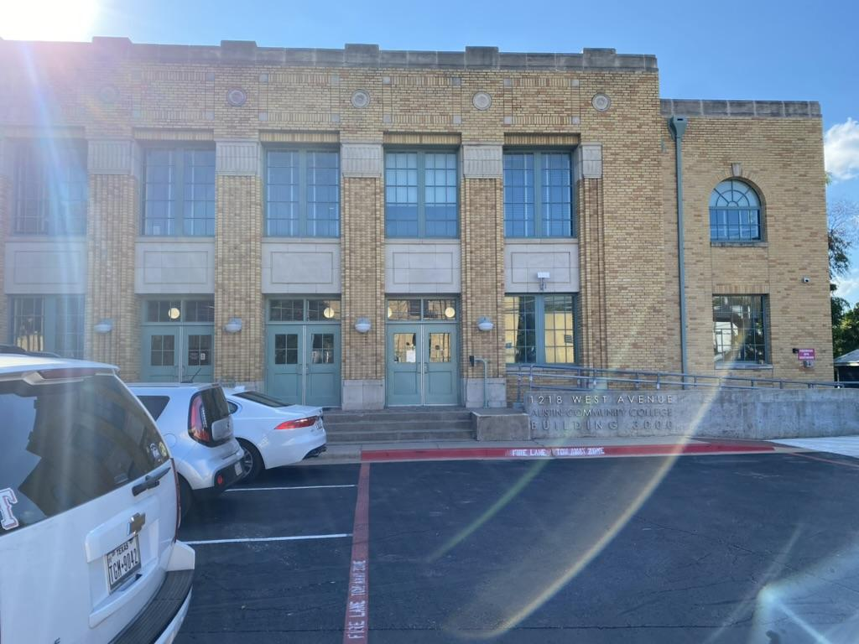
Finding US - ACC RGC-3000

Slide 15
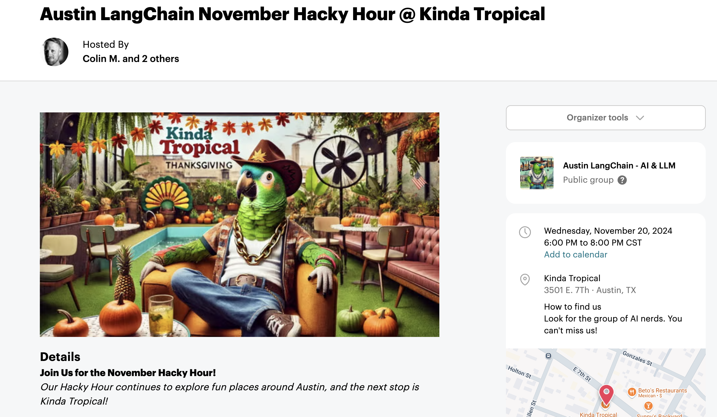
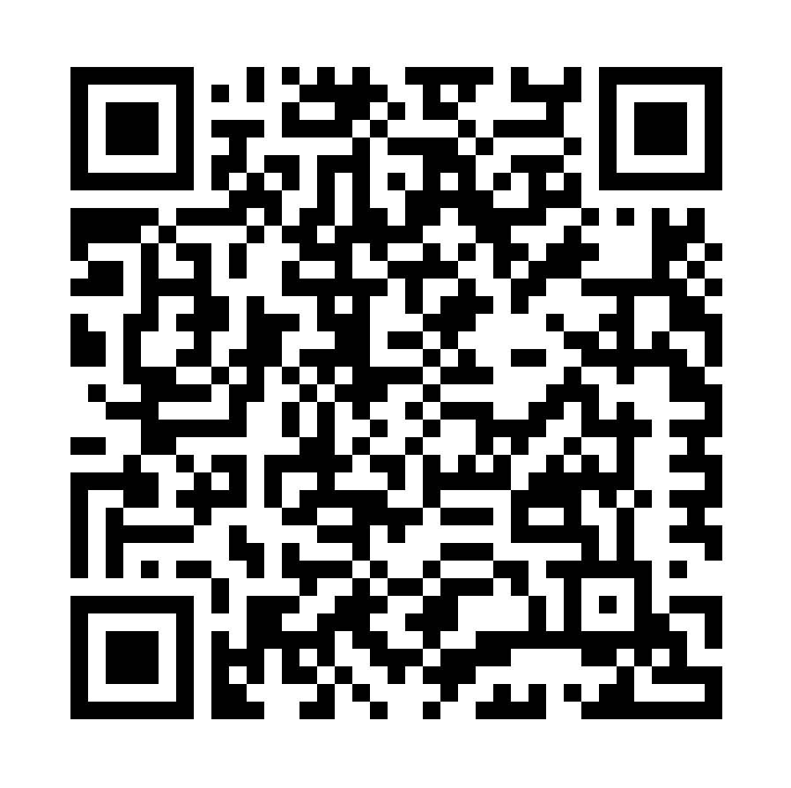
Next Event – Hacky Hour at Kinda Tropical
Respect & Inclusivity: Our only rule is simple: “Be cool to each other, don’t be gross.”
AI Enthusiasts of All Levels Welcome: We celebrate diverse perspectives and unique paths in AI.

